Slide 1


VGA Protocol
School of Electrical Engineering
Faculty of Engineering
Tel Aviv University

Slide 2
Understanding VGA protocol
What is a protocol?
Types of protocols
What is VGA
VGA signals
Screen synchronization
Hsync and Vsync timing
Digital RGB to analog connectorS

Slide 3
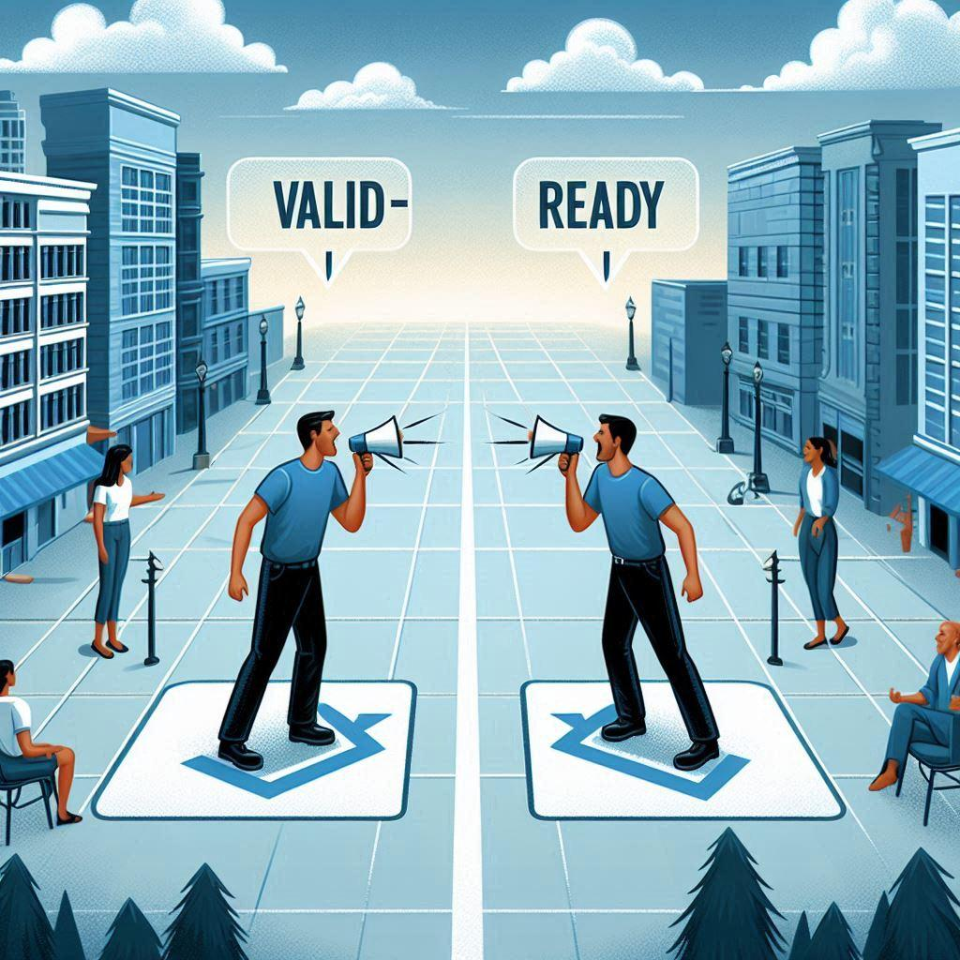
What is a protocol?
Definition: A protocol is a set of rules and conventions for data communication between devices
Purpose: Ensures reliable and standardized communication

Slide 4
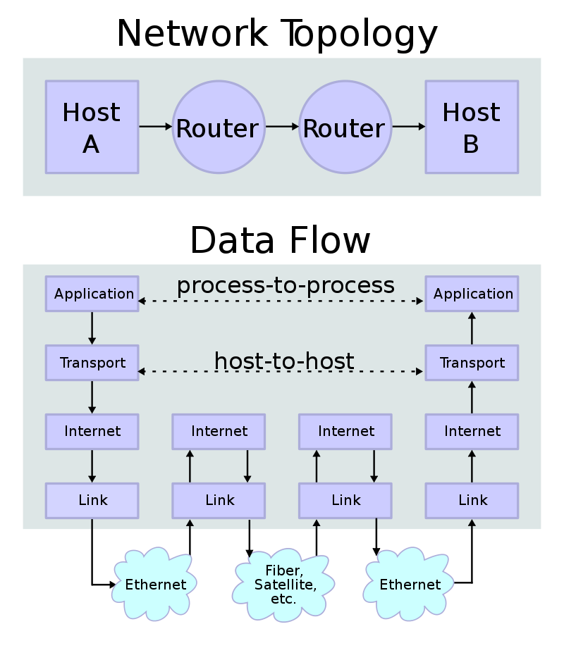
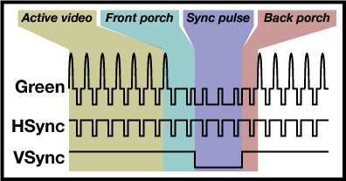
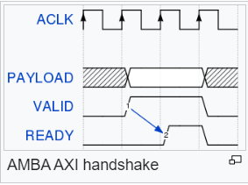
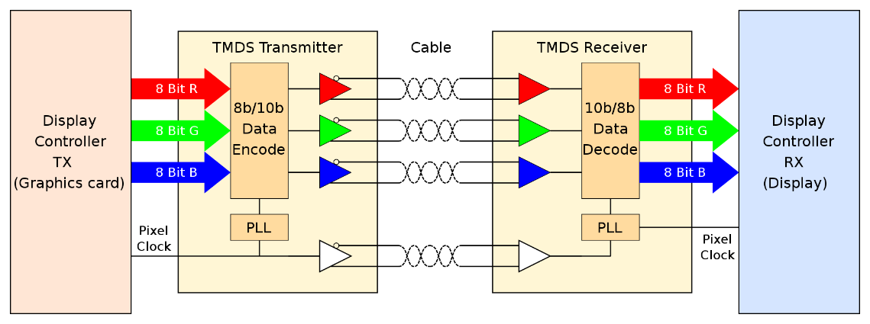
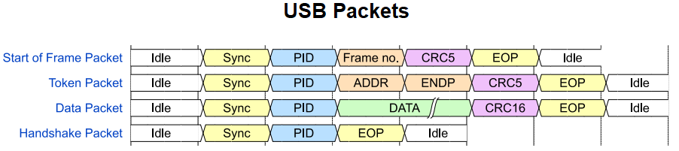
Types of protocols
Communication Protocols
AMBA (Advanced Microcontroller Bus Architecture)
USB (Universal Serial Bus)
Network Protocols
TCP/IP
Display Protocols
VGA (Video Graphics Array)
HDMI via TMDS

Slide 5
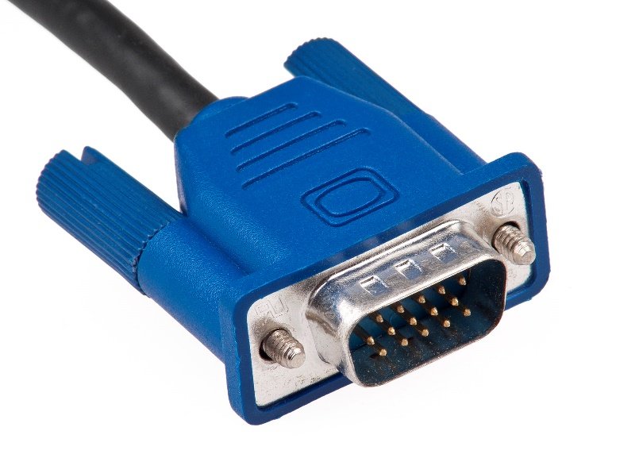
What is VGA?
Video Graphics Array (VGA) is a display standard introduced by IBM in 1987
VGA provides a method for displaying graphics on a monitor, defining the way pixels are rendered on the screen
A VGA monitor scans the screen row by row, starting at the upper left corner and ending at the lower-right corner

Slide 6
VGA signals
Hsync - Horizontal synchronization
Indicates the end of a line scan
Vsync - Vertical synchronization
Indicates the end of the screen scan
RGB – Pixel color

Slide 7
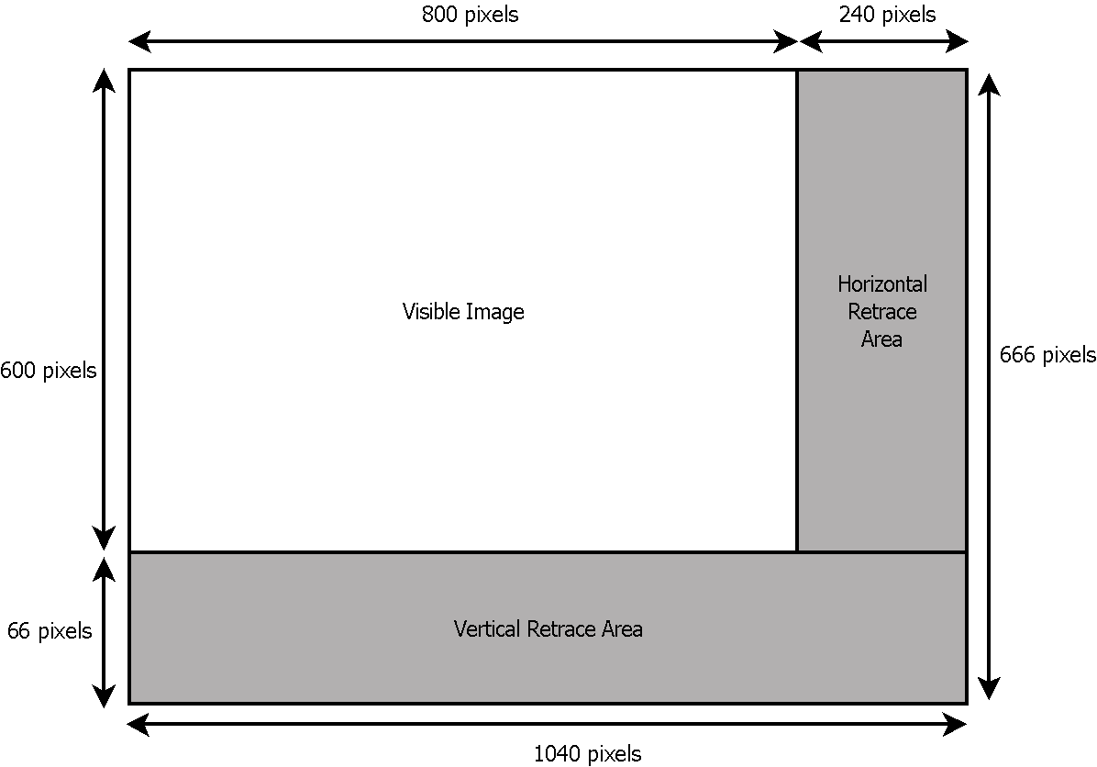
Screen synchronization
Pixel clock = 50MHz
Hsync freq = 48.07KHz
Vsync freq = 72Hz

Slide 8
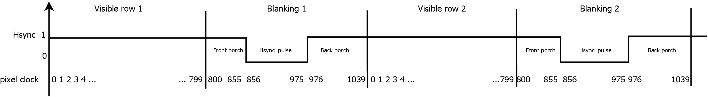
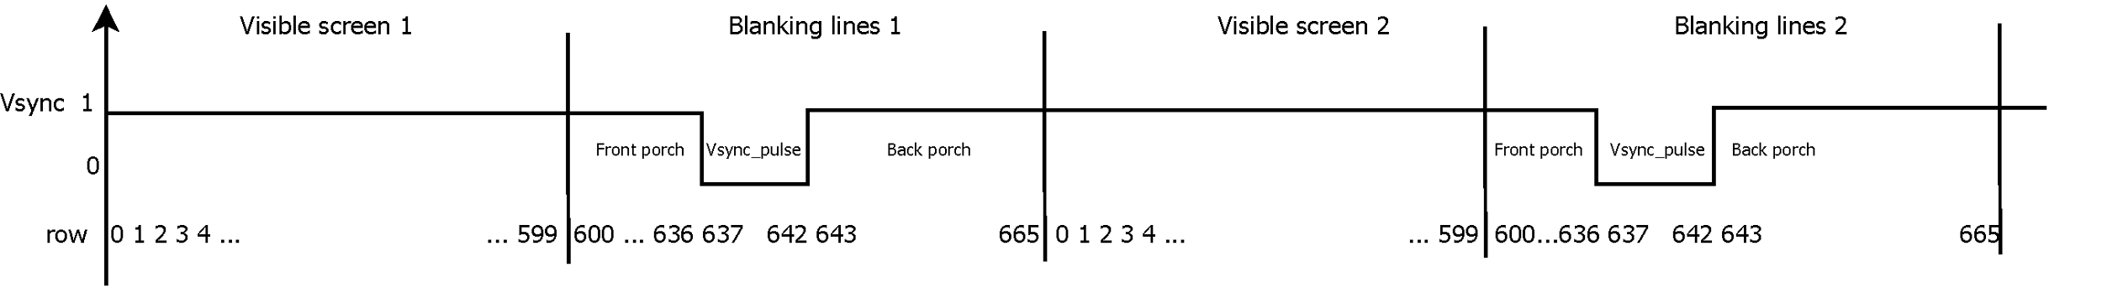
Hsync and Vsync timing
Hsync timing example:
Vsync timing example:

Slide 9
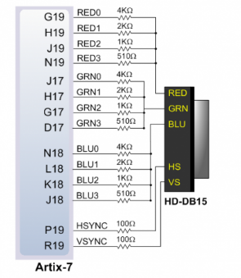
Digital RGB to analog connector
The VGA connector is analog
To express the RGB signal as analog, Basys3 uses DAC circuit as follows (Define the pins properly in your project):

Slide 10
Questions?

